Slide 1
Architecture patterns

Slide 2
Architectural patterns
An architectural pattern is a general, reusable solution to a commonly occurring problem in software architecture. It provides a set of guidelines and best practices for designing the structure and organization of software systems.
Architectural patterns help architects and developers to create software that is scalable, maintainable, and adaptable to changing requirements.

Slide 3
Architectural patterns
Architectural patterns are not specific to any programming language or framework, and can be applied to a wide range of software systems.
They provide a common vocabulary and set of guidelines for architects and developers to design and build software systems that are maintainable, scalable, and adaptable to changing requirements.
By using architectural patterns, developers can avoid common pitfalls and design systems that are more robust and flexible, making it easier to meet business objectives and deliver value to end-users.

Slide 4
Model-View-Controller
Some common architectural patterns used in software development include:
Model-View-Controller (MVC): This pattern separates an application into three interconnected components: the model (data and business logic), the view (user interface), and the controller (intermediary between the model and the view).

Slide 5
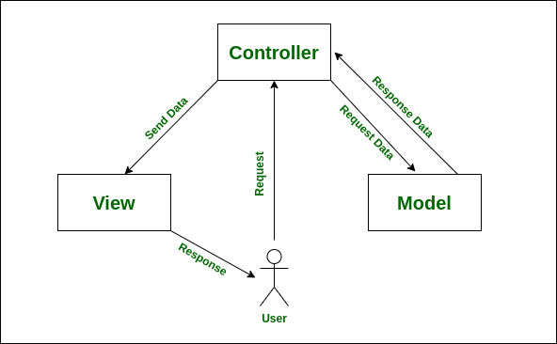
Model-View-Controller
MVC (Model-View-Controller) is a popular architectural pattern used in software development, particularly in web applications. It separates an application into three interconnected components: the model, the view, and the controller.

Slide 6
Model-View-Controller
The three components of MVC are:
Model: The model represents the data and business logic of the application. It encapsulates the data and provides methods for accessing and manipulating it. The model is responsible for ensuring data integrity and consistency.
View: The view is responsible for rendering the user interface of the application. It receives data from the model and displays it to the user. The view is typically implemented using HTML, CSS, and JavaScript.
Controller: The controller acts as an intermediary between the model and the view. It receives input from the user, interacts with the model to retrieve or modify data, and then passes that data to the view for rendering. The controller is responsible for handling user interactions and coordinating the flow of data between the model and the view.

Slide 7
Model-View-Controller
The benefits of using the MVC pattern include:
Separation of concerns: By separating the application into distinct components, MVC promotes a clear separation of concerns, making it easier to understand and maintain the code.
Reusability: Since each component is independent of the others, they can be reused in other parts of the application or in other applications altogether.
Testability: Testing each component separately is easier and more effective than testing the application as a whole.
Flexibility:MVC is a flexible pattern that can be adapted to different types of applications and use cases. It allows for changing one component without affecting the others, making it easier to modify and extend the application.

Slide 8
Model-View-Controller
In web development, MVC is commonly used in frameworks like Laravel, Ruby on Rails, and Spring MVC. In these frameworks, the model is typically represented by database tables or object-relational mapping (ORM) frameworks, while the view is rendered using templating engines like Blade, ERB, or Thymeleaf. The controller is implemented as a class that handles incoming requests and sends responses back to the client.

Slide 9
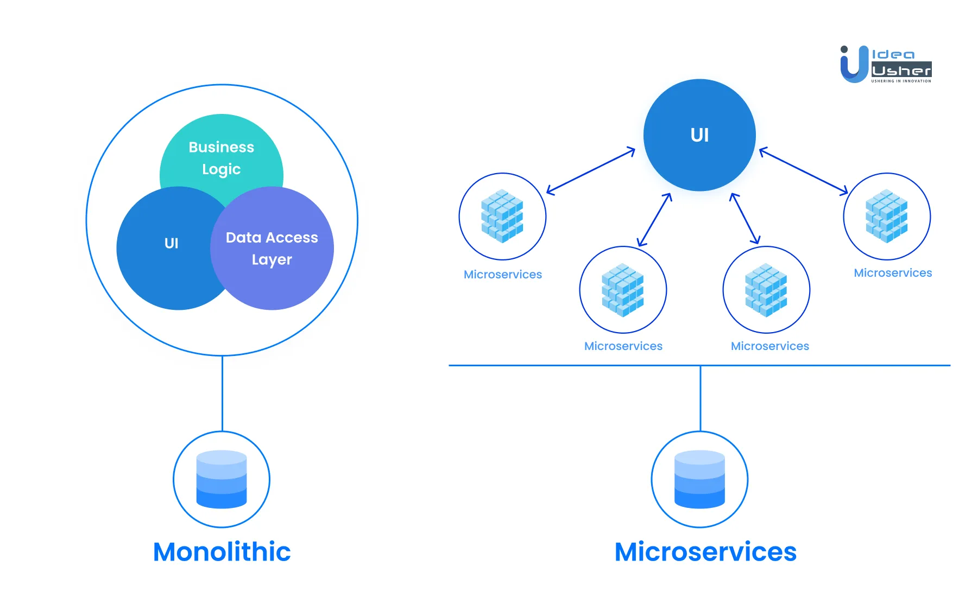
Microservices
Microservices: This pattern decomposes a large system into smaller, independent services that communicate with each other through APIs. Each microservice is focused on a specific functionality, making it easier to maintain and scale the system.

Slide 10
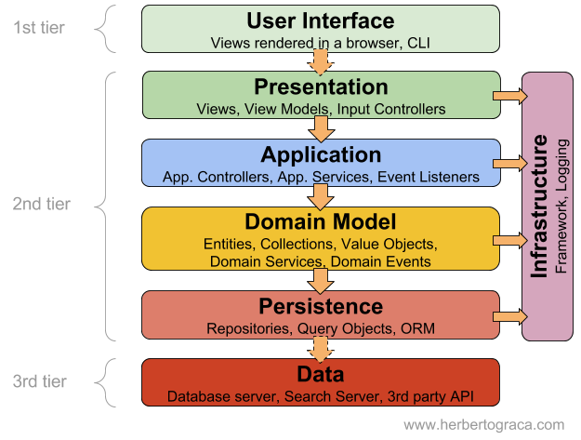
Layered architecture
Layered architecture: This pattern separates an application into layers based on functionality, with each layer dependent only on the layer directly beneath it. The layers typically include presentation, business logic, and data storage.

Slide 11
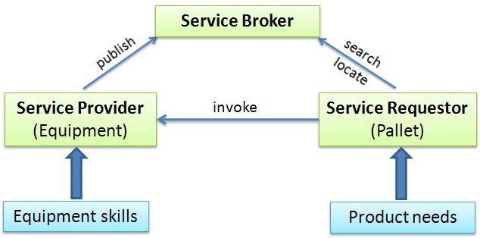
Service-oriented architecture (SOA)
Service-oriented architecture (SOA): This pattern separates an application into services that communicate with each other through well-defined interfaces. Each service is responsible for a specific functionality and can be developed and maintained independently.

